Slide 1
Examining Hospital Surgery Data
Helen Cain -- DS-5010 Final Project

Slide 2

My Dataset:

Slide 3
My Goal:
IInfo:
One entry for each procedure
Medications:
One entry for each prescription
Complications:
One entry for each complication
Diagnoses:
One entry for each diagnosis
Patients: one entry for each patient

Slide 4
What did I learn?

Slide 5
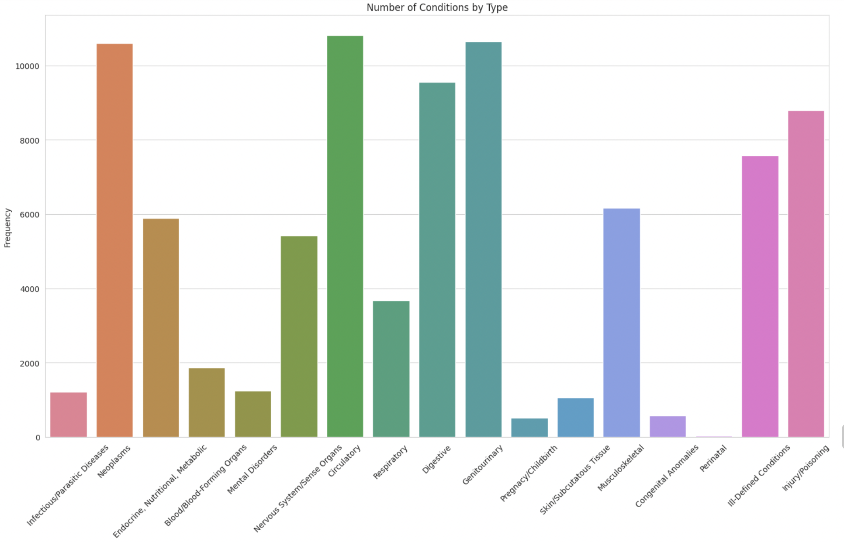
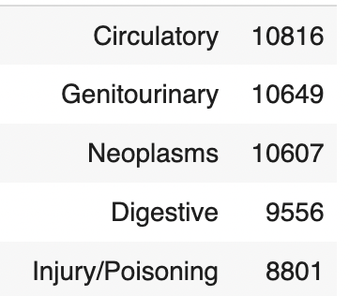
Conditions and Procedures:
Top 5:

Slide 6
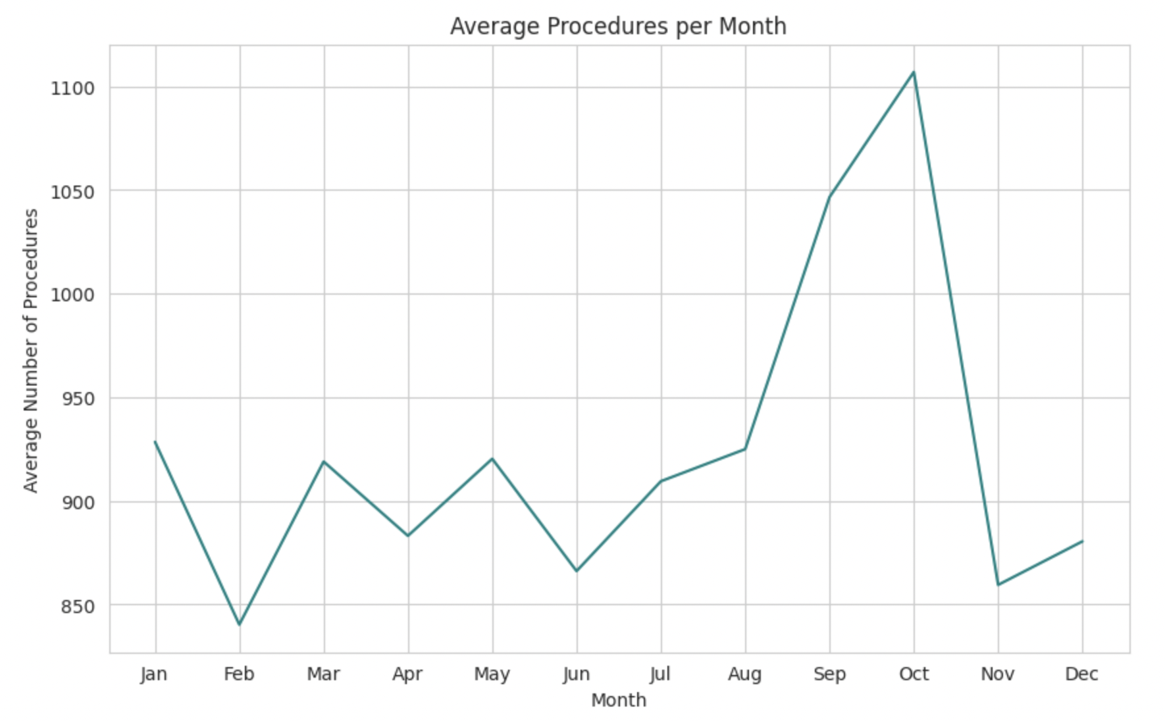
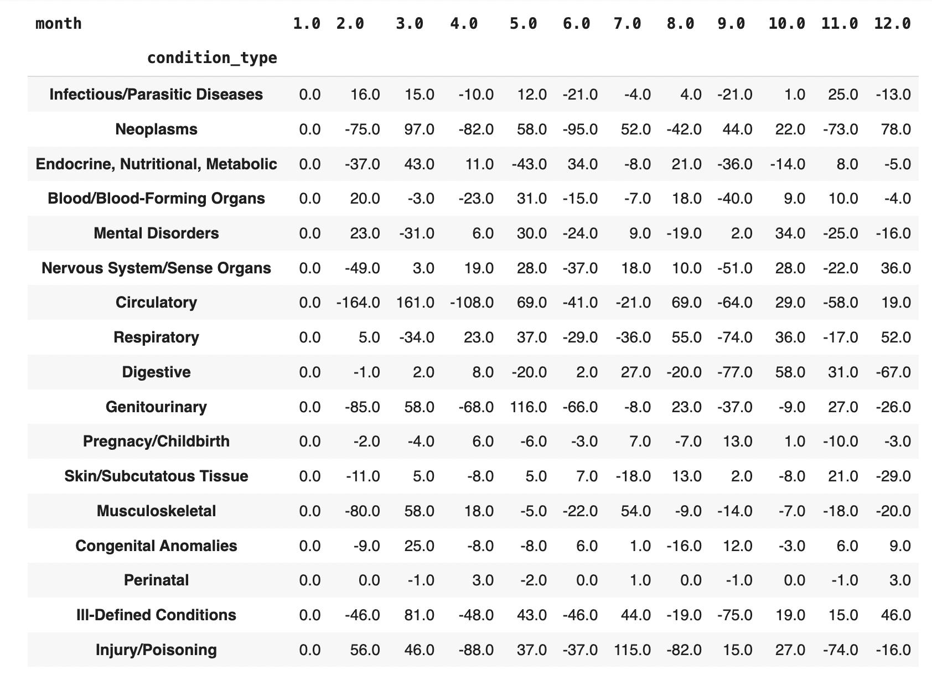
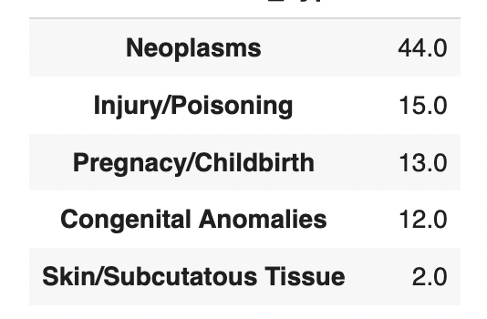
Seasonal Patterns:

Slide 7
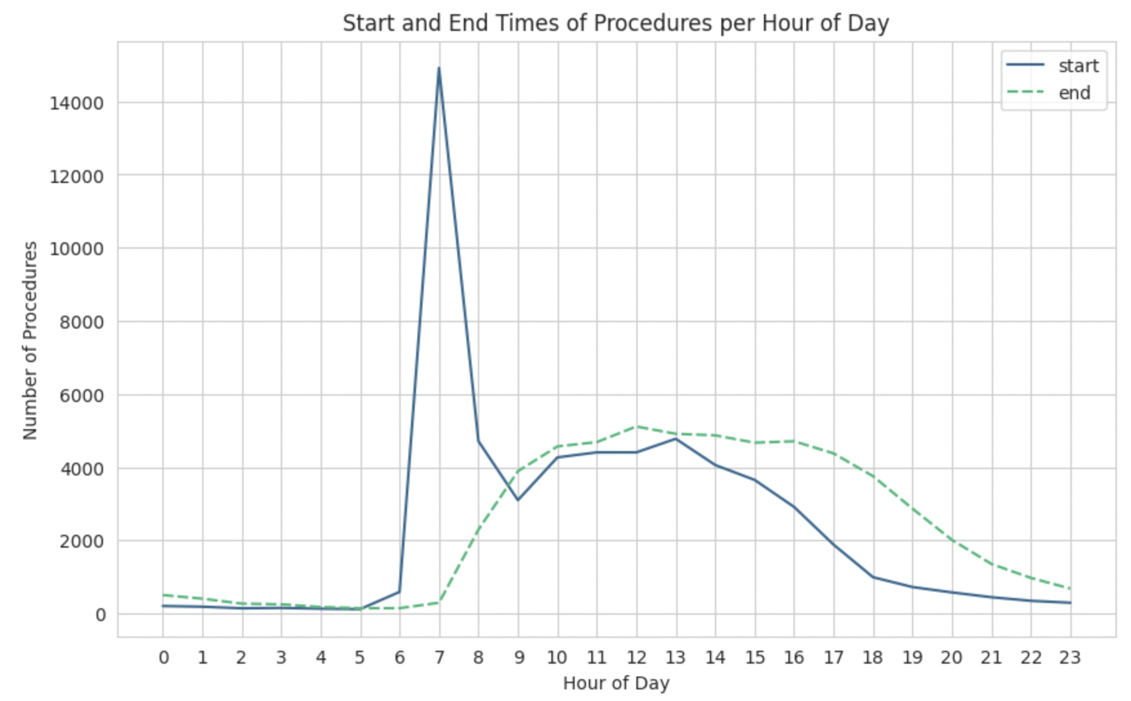
Longest Procedures:
Breast reconstruction- 13.5 hours
Whipple procedures - 10.5 hours
Free flap surgery - 10.25 hours

Slide 8
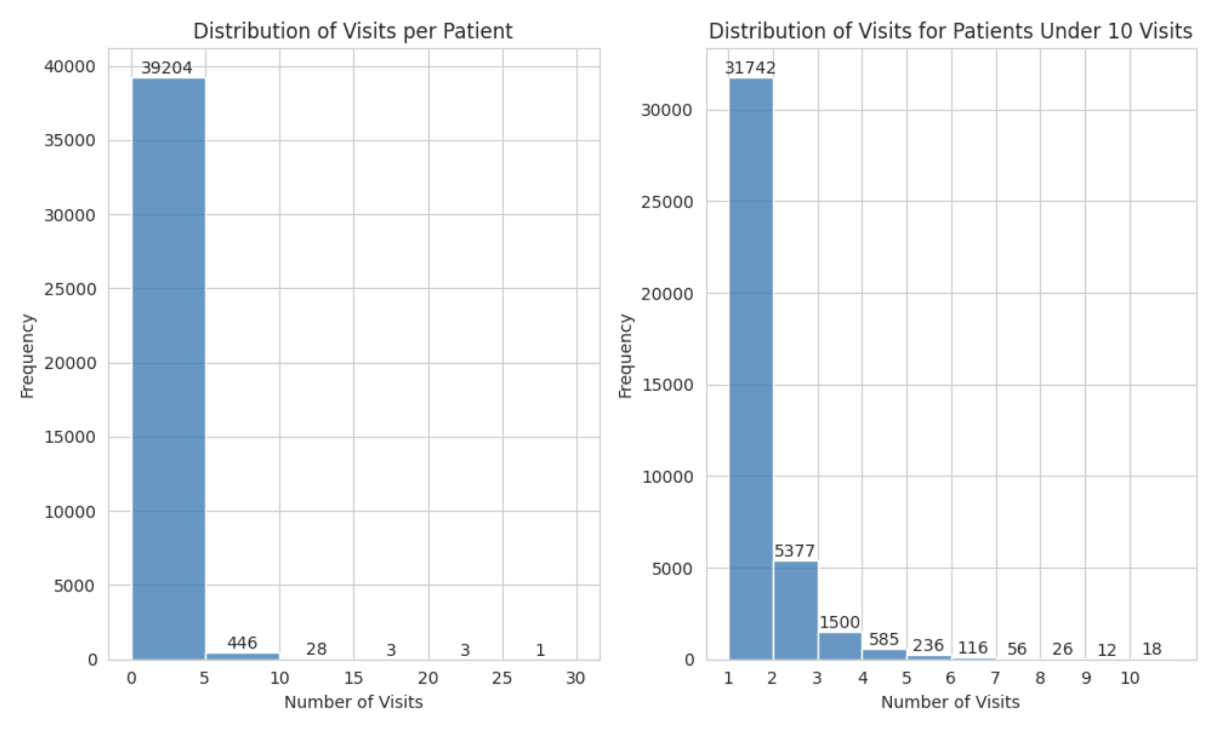
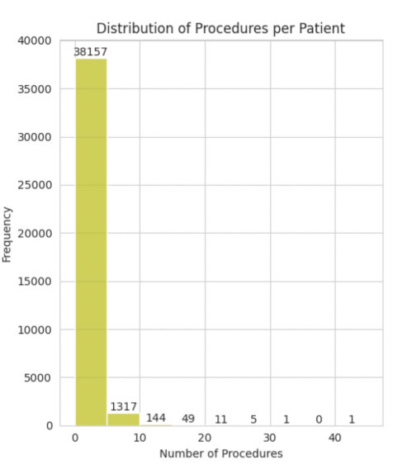
Hospital Visits vs Hospital Procedures:

Slide 9
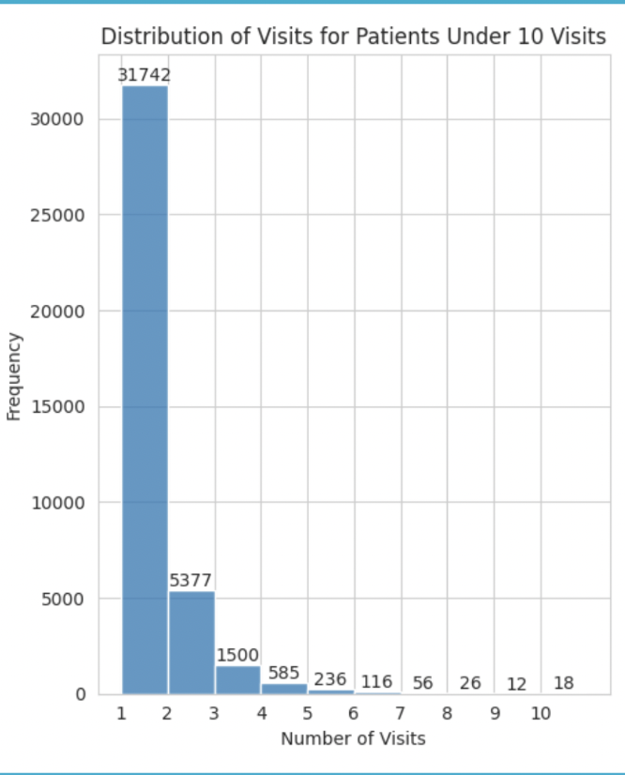
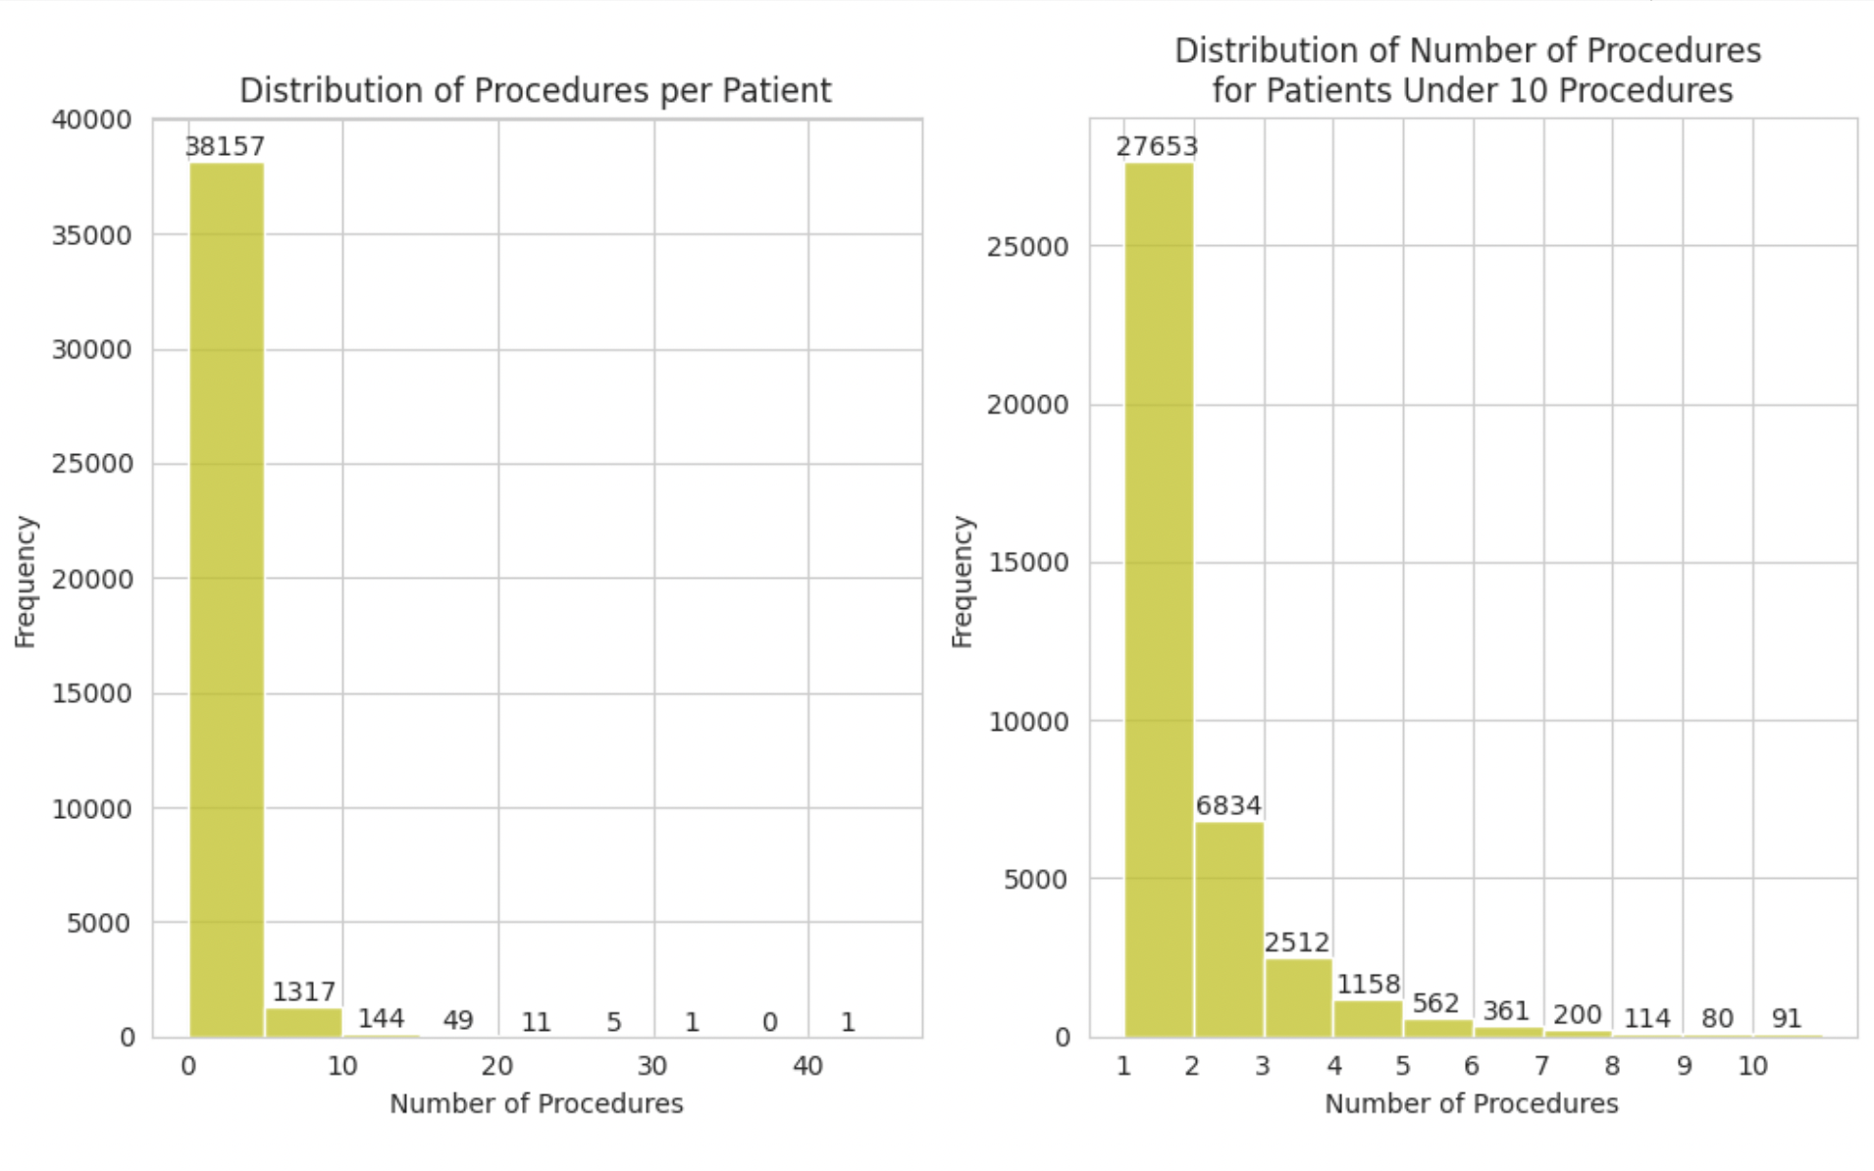
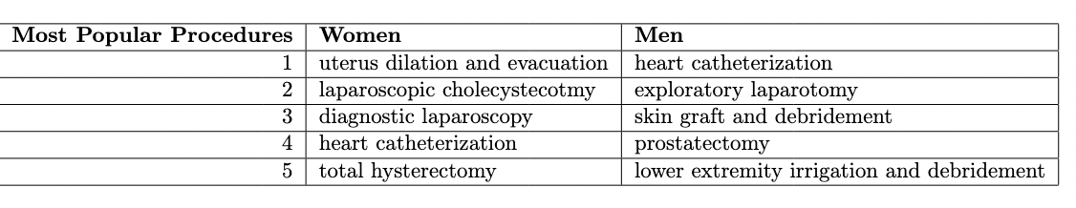

Slide 10
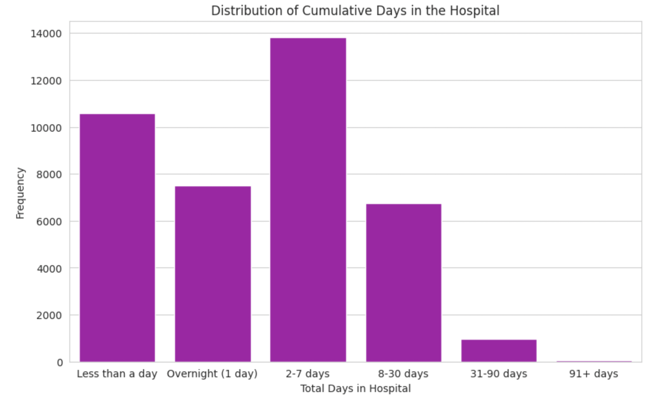
Lengths of Stay

Slide 11
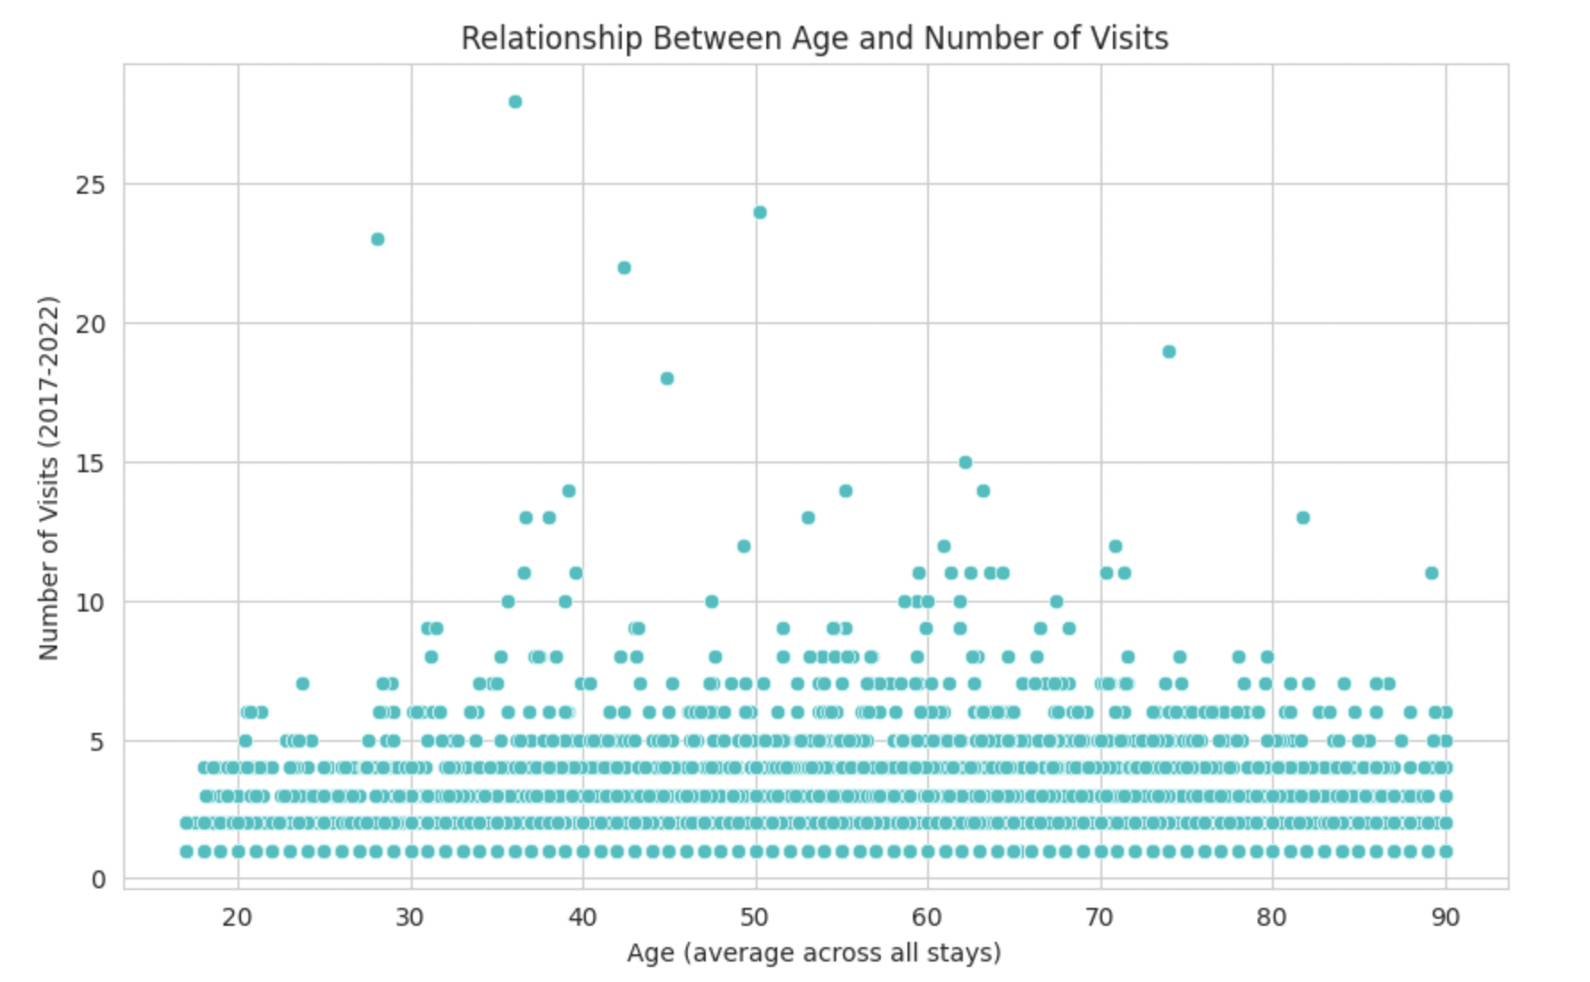
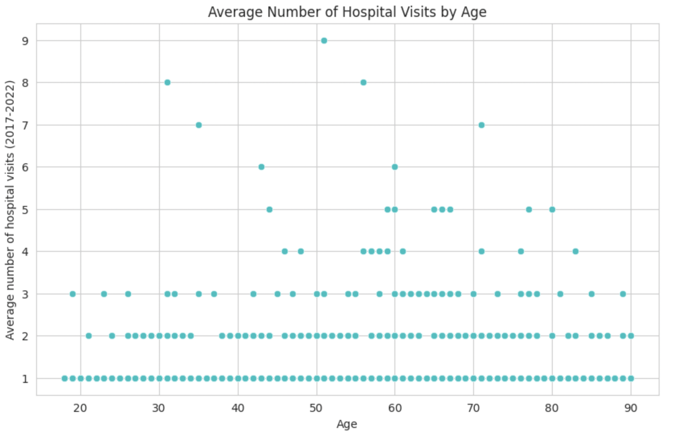
Do older people get more surgeries?

Slide 12
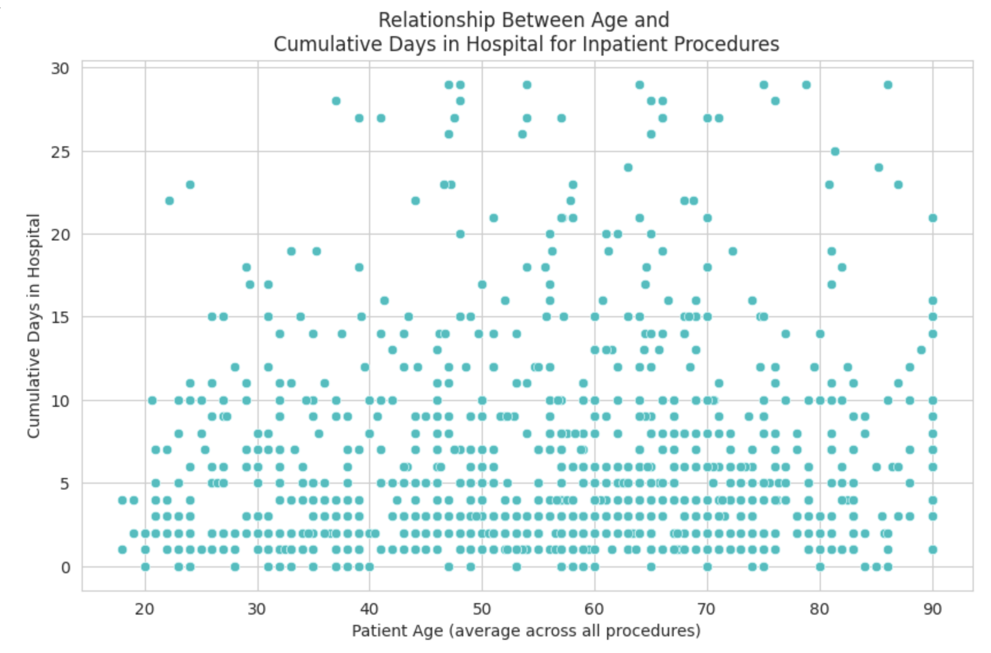
Do older people stay in the hospital longer?

Slide 13
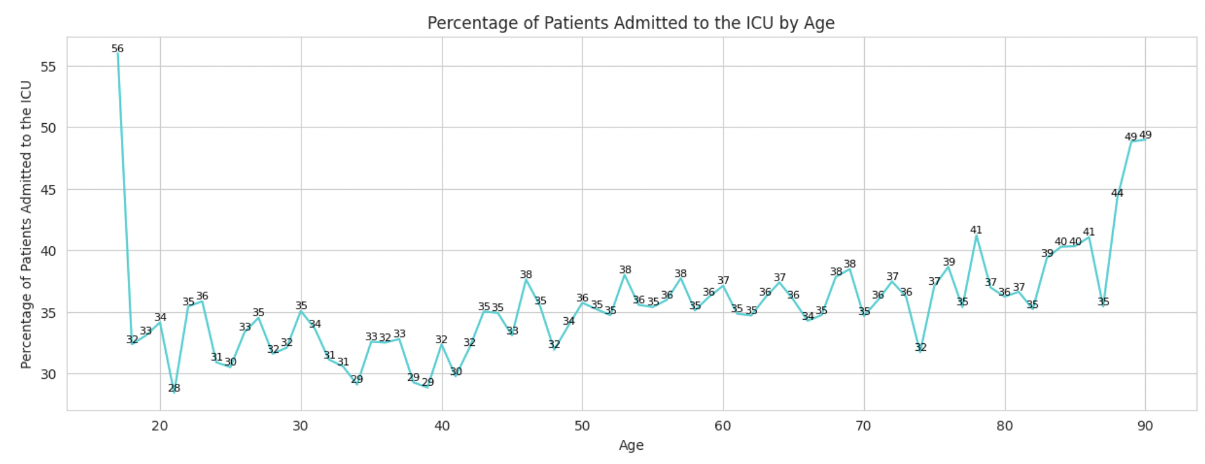
Are older people admitted to the ICU more often?

Slide 14
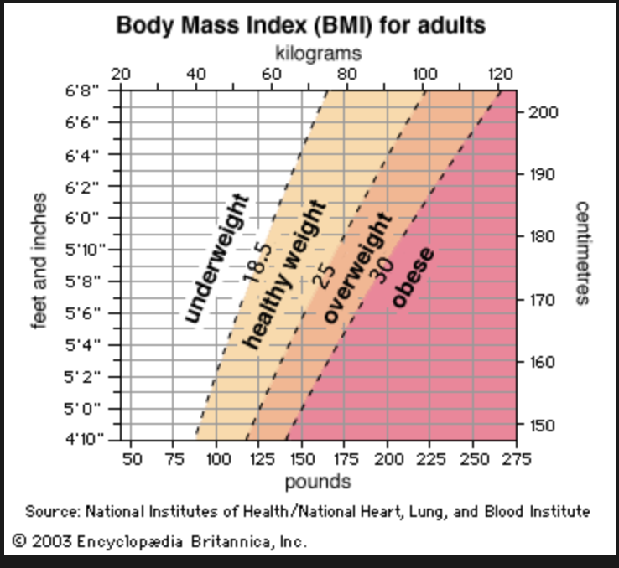
BMI

Slide 15
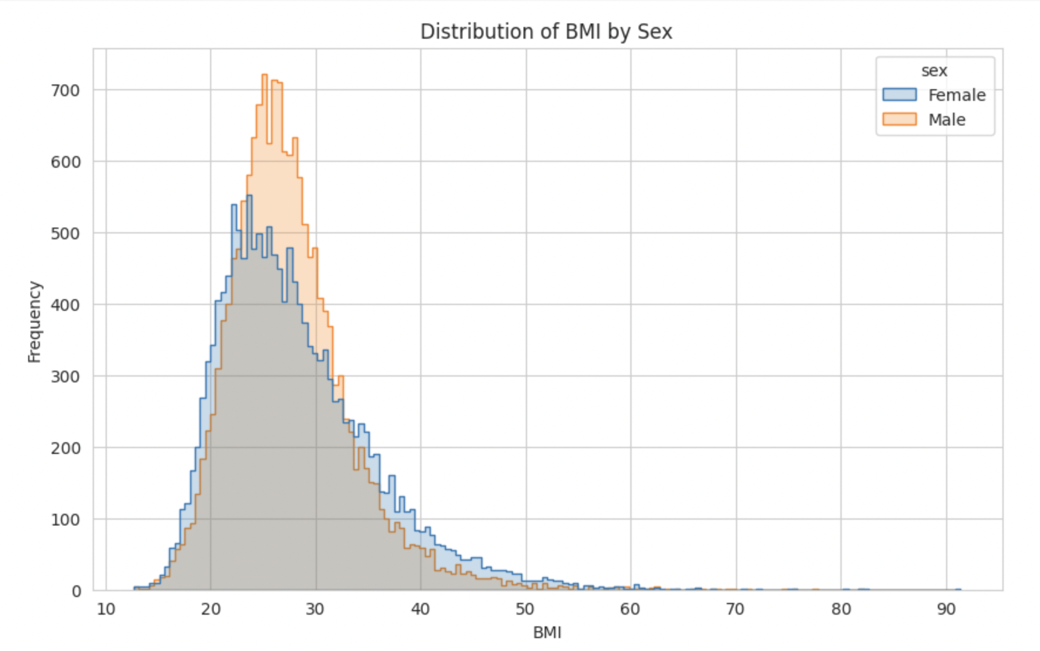
Distribution

Slide 16
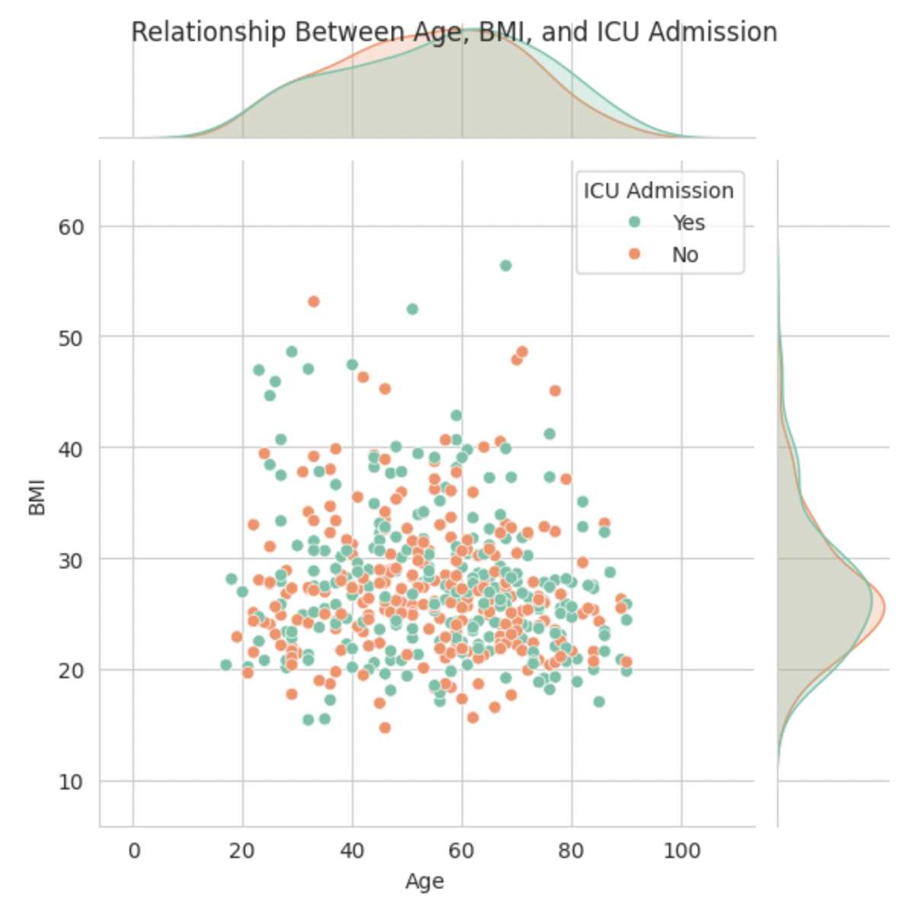
Can BMI and age be used to predict ICU admissions?

Slide 17
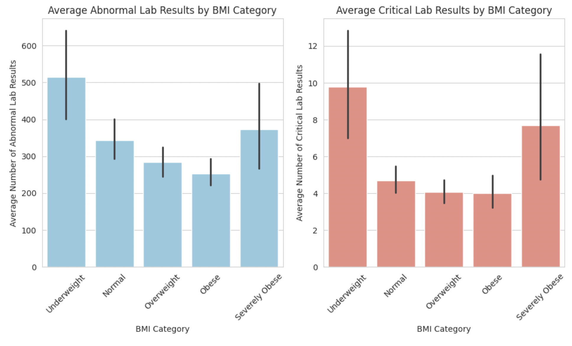
Does BMI affect lab tests?

Slide 18

Post-Operative Complications

Slide 19
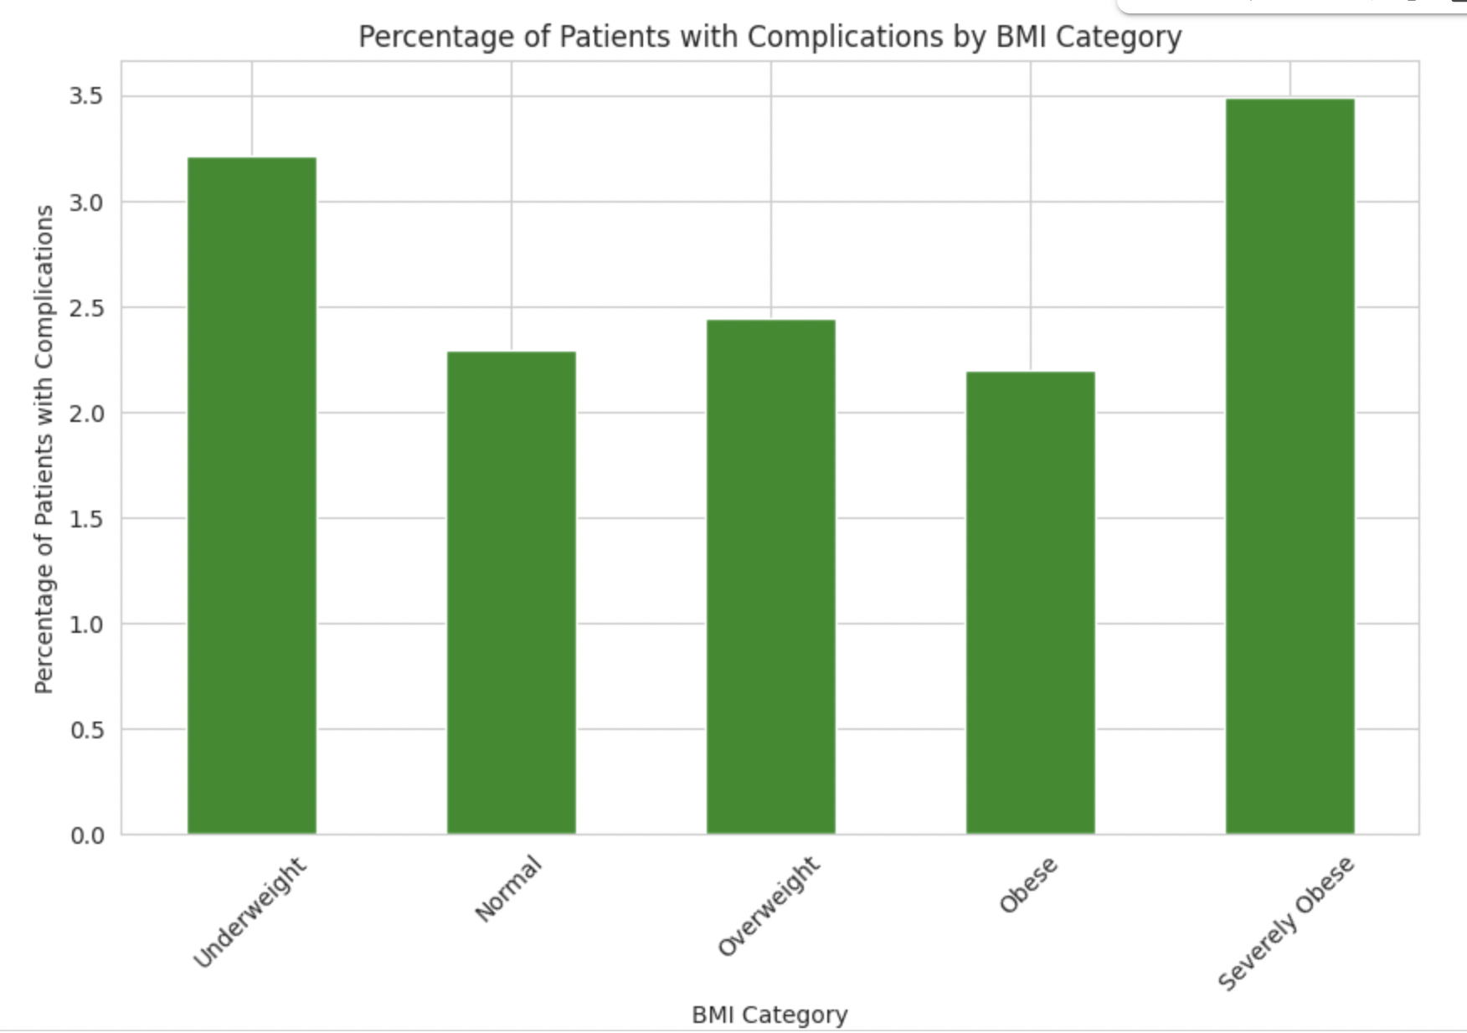
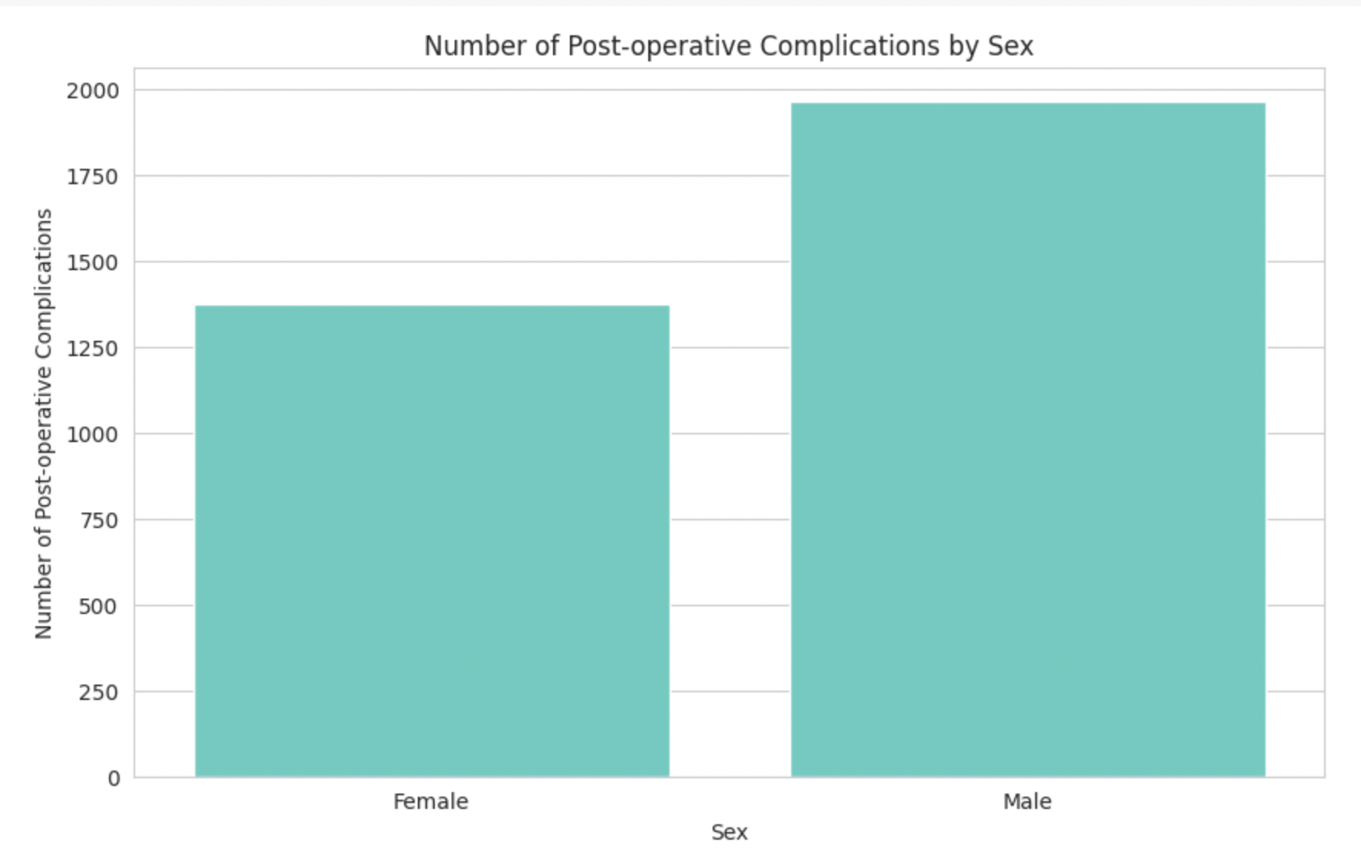
Which patients experienced complications?
Total percentage: 3.49

Slide 20
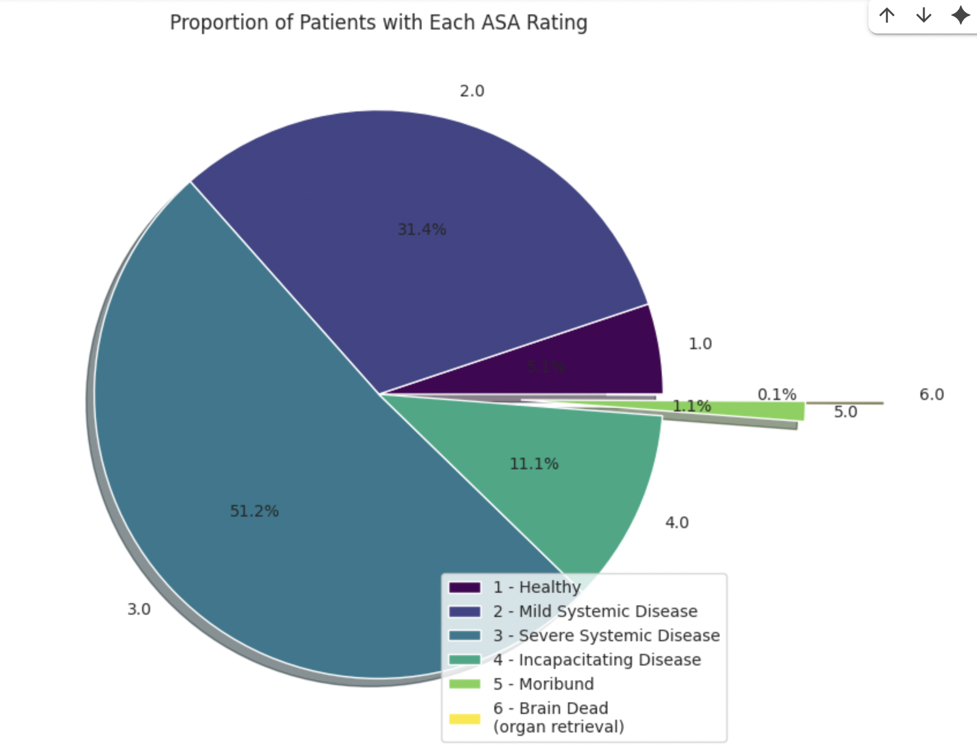

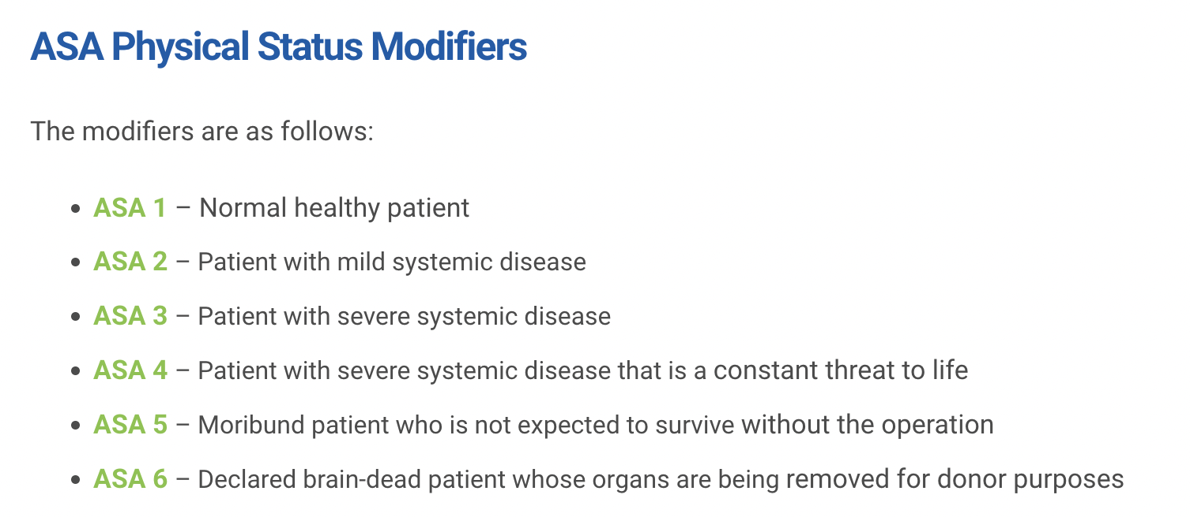
What is ASA Physical Status?

Slide 21
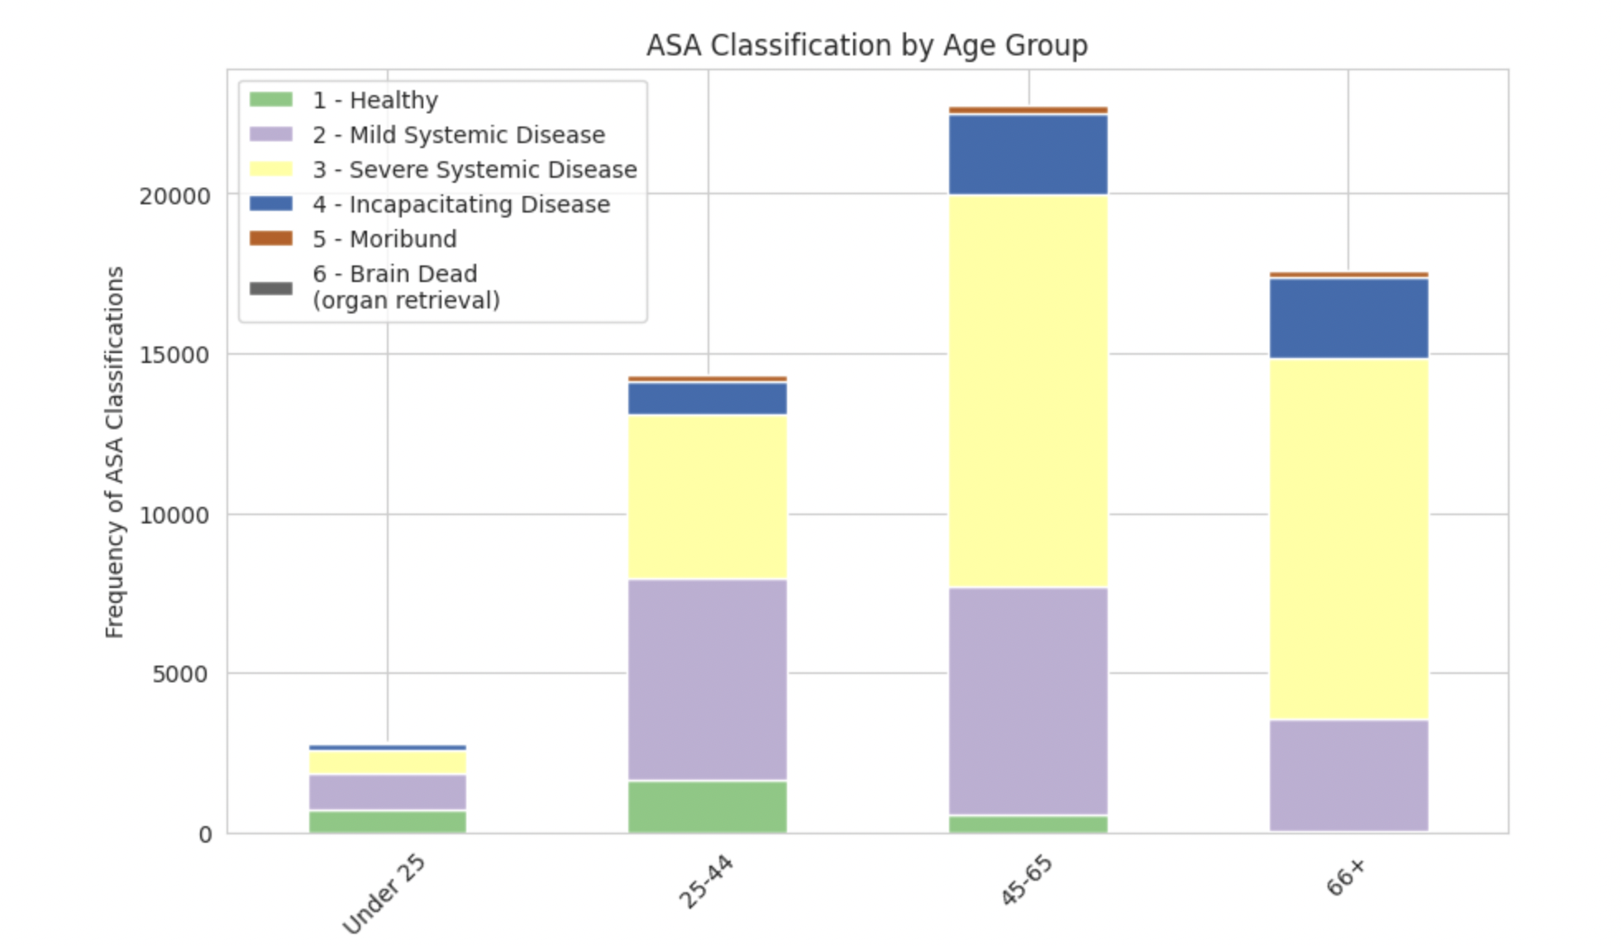
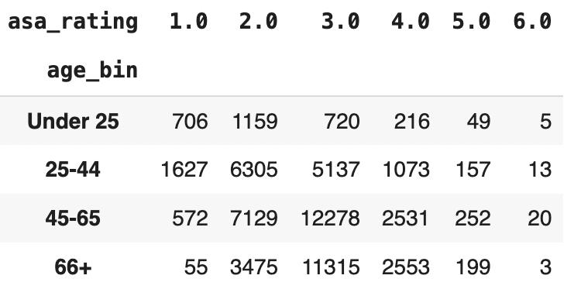
Are older patients sicker patients?

Slide 22
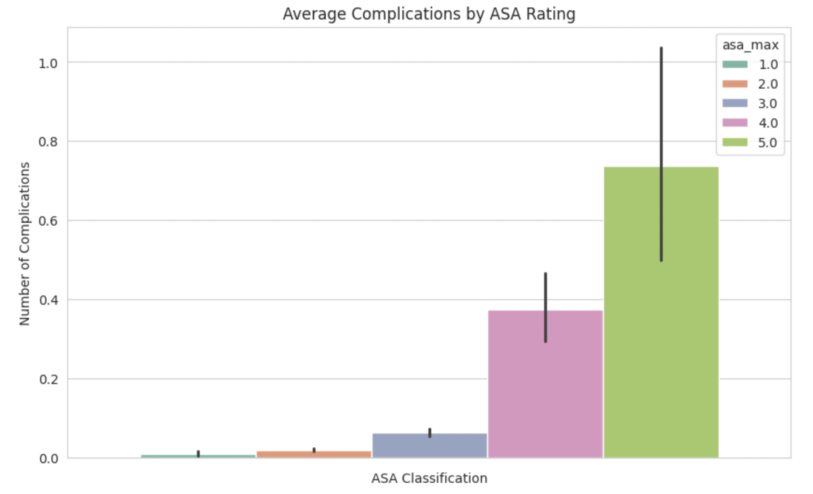
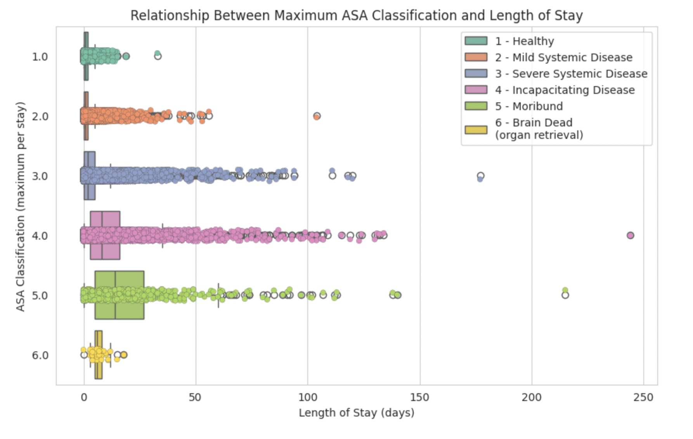
ASA and Surgical Outcomes

Slide 23
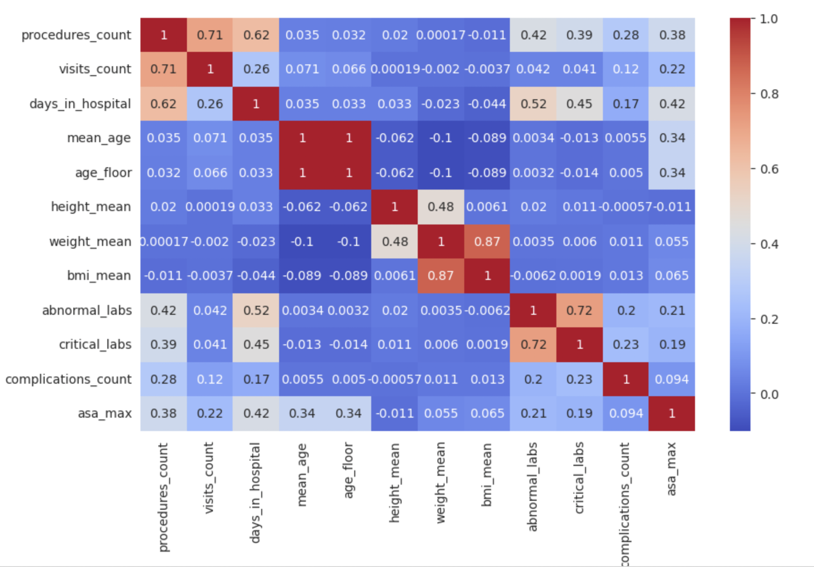
CONCLUSIONS
Hospital data is very comprehensive, but very messy
Surgical outcomes are difficult to predict without more advanced statistical methods

